Slide 1
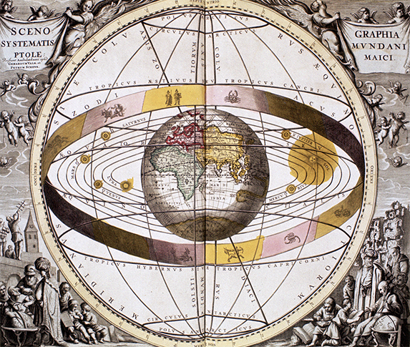
The Renaissance and Reformation (1300–1650)
Topic 4 Lesson 5 The Scientific Revolution

Slide 2
The Renaissance and Reformation (1300–1650)
Lesson 5 The Scientific Revolution
Key Terms
Nicolaus Copernicus
heliocentric
Tycho Brahe
Johannes Kepler
Galileo Galilei
scientific method.
Francis Bacon
René Descartes
hypothesis,
Robert Boyle
Isaac Newton
calculus
gravity

Slide 3
The Renaissance and Reformation (1300–1650)
Topic 4 Lesson 5 The Scientific Revolution
Learning Objectives
Explain how new discoveries in astronomy changed the way people viewed the universe.
Understand the new scientific method and how it developed.
Identify the contributions that Galileo, Copernicus, Newton, and other scientists made to the Scientific Revolution.

Slide 4
Changing Views of the Universe
Old Views
Before the mid 1500’s scholars believed Ancient Greeks like Aristotle and Ptolemy
Copernicus Offers a New Theory
Copernicus in 1543 proposes that the sun is the center of the universe and that the planets rotate around it
Most experts will reject this idea
Danish astronomer Tycho Brahe provided data supporting Copernicus by observing the movement of heavenly bodies
Johannes Kepler will use Tycho’s data to calculate the orbits of planets moving around the sun proving Copernicus right
The Church Rejects Galileo’s Discoveries
Galileo will assemble a telescope, and with it he will see the mountains on the moon and the moons of Jupiter revolve
The Church will condemn him because his idea challenges the notion that the heavens are fixed, unmoving, and perfect

Slide 5
Changing Views of the Universe
In 1633 Galileo is tried for heresy and faces death. He agrees to proclaim that the earth stood motionless in the center of the universe in court. He does so and as he leaves the court, according to legend, mutters “And yet it moves”

Slide 6
Changing Views of the Universe
The ancient Greek astronomer Ptolemy believed that the Earth was at the center of the universe and the sun and stars revolved around it. This is an image of Ptolemy’s Geocentric Universe.

Slide 7
A New Scientific Method
Revolutionary Scientific Thinkers
New scientific method is actually a revolution in thought
Francis Bacon (English) and Rene Descartes (French) devoted themselves on how truth is determined
Both will argue that truth is not known at the beginning of inquiry but at the end after a long process of investigation
Bacon will stress experimentation and observation
Descartes emphasized reasoning as the best road to understanding. He will come up with “I think, therefore I am”
A Step-By-Step Process
Scientists would gather data and to explain the data they would form a hypothesis, then test it with experiments and observation
For the first time mathematical calculations were used to covert the observations and experiments into scientific laws
Bacon and Descartes approach will bring in more revolutionary ideas of thinking in the 1700s

Slide 8
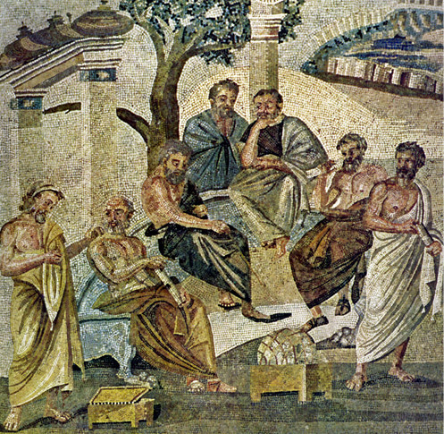
A New Scientific Method
Ancient Greek philosopher Plato meets with students and other philosophers. Plato taught that man should look beyond appearances to learn nature's truths. His teachings were rediscovered by Renaissance scientists and helped shape people's view of the physical world.

Slide 9
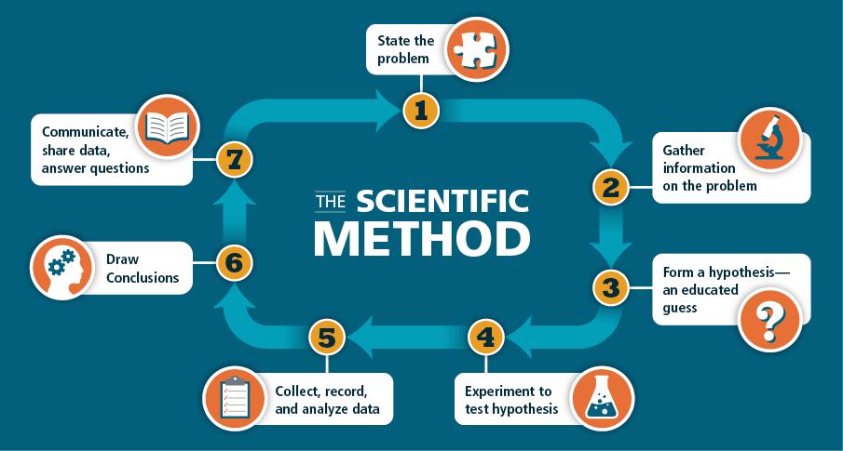
A New Scientific Method
Analyze Information The scientific method, still used today, is based on careful observation and measurement of data. Why do you think it’s critical to follow each step in sequence and to follow the same procedure for each step?

Slide 10
Breakthroughs in Medicine and Chemistry
Exploring Human Anatomy
Medieval physicians relied on Galen, but he had made many errors in his work
1543 Andreas Vesalius will create the first accurate and detailed study of human anatomy, correcting errors from before
Ambroise Pare invents better ointment to prevent infection, better ways to seal wounds during surgery, various scientific instruments, and prosthetic limbs
William Harvey (English) will describe the circulation of blood for the first time and show that the heart pumps blood through veins
The Microscope
Anton Leeuwenhoek (Dutch) perfects the single lens microscope
He will look at water and see tiny organisms and be the first human to see cells and microorganism
He will be called the founder of microbiology

Slide 11
Breakthroughs in Medicine and Chemistry
The New Science of Chemistry
First known as alchemy, during the scientific revolution it will free itself from any magical notions
Robert Boyle (English) explained that all matter was composed of tiny particles that behave in knowable ways. This will open the way to modern chemical analysis of the composition of matter
Isaac Newton Links the Sciences
He’s English and has a brilliant theory why planets moved the way they did. He spends 20 years perfecting his theory, inventing calculus along the way
1687 he explains gravity and how all motion in the universe can be measured and described mathematically
This seems to link the sciences of physics and astronomy with mathematics like gravity binds the universe together
He will be one of the most influential scientist of all time

Slide 12
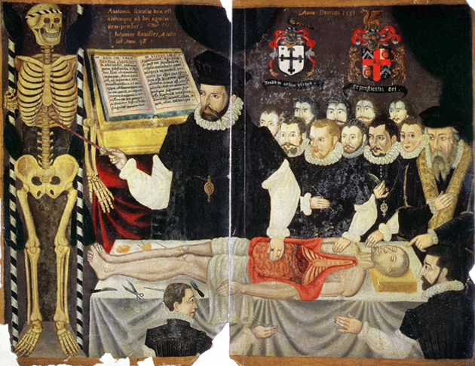
Breakthroughs in Medicine and Chemistry
English surgeon John Banister dissects a corpse to teach students about human anatomy. New approaches to scientific investigation helped to change how physicians learned about the human body.

Slide 13
Quiz: Changing Views of the Universe
How did the discoveries of Copernicus and other astronomers affect the way people viewed the universe?
A. Their experiments proved that the ancient classical astronomers had been correct about how the universe functioned.
B. Their observations supported the Ptolemaic view of the universe.
C. Their discoveries reinforced traditional Church teachings on the relationship between Earth and the stars and other planets.
D. Their observations proved that the universe was heliocentric.

Slide 14
Quiz: A New Scientific Method
The ideas of Francis Bacon and René Descartes led to a new scientific method because they both believed that
A. the discoveries of the ancient philosophers were valid but should be documented in a modern way.
B. truth could only be determined after a process of investigation.
C. the traditional teachings of the Church should form the basis of all scientific inquiry.
D. basic scientific fact is obvious to those who look hard enough at available data.

Slide 15
Quiz: Breakthroughs in Medicine and Chemistry
Some of the most profound work of the Scientific Revolution came from Isaac Newton. His work included
A. the discovery of the human circulatory system and how the heart acts to pump blood through that system.
B. developing a microscope that was powerful enough to see tiny organisms invisible to the naked eye.
C. discovering that specific chemicals are the building blocks of life.
D. the discovery that nature follows uniform laws and that all motion in the universe can be measured and described mathematically.

